Slide 1
Object Oriented Programming (OOP) in Python
Dr Ahmad Tarawneh

Slide 2
Outline
What is OOP
Classes vs Objects
Introduction to Processing
Principles of OOP
Benefits of OOP in Python

Slide 3
OOP
In Python, object-oriented Programming (OOPs) is a programming paradigm that uses objects and classes in programming.
It aims to implement real-world properties like inheritance, polymorphisms, encapsulation, etc.
The main concept of OOPs is to bind the data and the functions that work on that data together as a single unit
no other part of the code can access this data or functionality.

Slide 5
Classes
A class contains the blueprints or the prototype from which the objects are created.
It is a logical entity that contains some attributes and methods.
Assume that you want to track a number of individuals, each of which has its attributes: age, eye color, weight, etc.
if you implement this as a list, then the first element will be his age, second, eye color and the third is his weight.
What about the second person, or imagine you have 100 persons
This results in a lack of organization. Especially, when you want to add new attributes

Slide 6
Cont.
In such cases you need a blueprint that makes you able to create different instances from the same category, each of them has its characteristics.
This is called a class
A class in Python can be created using the class keyword
class ClassName: # Statement-1 . . . # Statement-N

Slide 7
Objects
Object is any instance that is created from a class.
The objects have the attributes included in its class (from which they are created), but might hold different values
Objects consist of:
State: It is represented by the attributes of an object.
Behavior: It is represented by the methods of an object.
Identity: It gives a unique name to an object and enables one object to interact with other objects.

Slide 8
Creating a class
As mentioned earlier, the class can be created using the class keyword.
Assume that you want to create a class for human
By convention, class name starts with a capital letter
class Human:
pass

Slide 9
Creating an object
An object can be created from a class, and it should have a name.
The above statement creates an object called object1 from the class Human
Check the following code:
object1 = Human()
class Human:
name = "Ahmad"
object1 = Human()
object2 = Human()
object1.name
object2.name
A class attribute (not instance an attribute) It can be accessed from any instance but can be modified by the class

Slide 10
Cont.
The previous code creates two different objects from the class Human
Two humans
However, these objects hold the same name, even though they are different objects
So, how can the class create objects with different characteristics and behaviors?

Slide 11
Self
To make each object have its own characteristics and functionality, we need an entity that refers to the object itself
This entity is called self => which means the object itself
Take a look at the modified version of the code
There are two new main components in this code
self
def __init__
class Human:
def __init__(self,name):
self.name = name

Slide 12
Self and __init__
Self is a convention used to reference the instance of a class within the class itself
__init__ is like the constructor in C++, a special method used for attributes initialization
The self in the signature of this method, __init__, refers to the instances created from this class, each has its attribute values
self needs to be passed as an argument to any instance method created from that class

Slide 13
Cont.
Now let us create new objects from the Human class.
Now every object has its characteristics, here is the name.
self can be used with attributes as well, not only methods
This means the name attribute in an object is the name that comes during the creation of that object
object1 = Human("Ahmad")
object2 = Human("Maher")
print(object1.name, object2.name)
self.name = name

Slide 14
Methods
The previous example shows a characteristic of objects (name).
The actions can be added to the object through methods
methods are functions that belong to instances and can be called on each object
there are methods that belong to the class as well
Let us add two methods,
one called sayInfo: let that human say his name
one called eat to make that human start eating

Slide 15
class Human: def __init__(self,name): self.name = name
def sayInfo(self): print (f"My name is { self.name}")
def eat(self): print (f"{ self.name} is eating right now!") h1 = Human("Ahmad") h2 = Human("Sara") h1.sayInfo() h1.eat() h2.eat()
My name is Ahmad
Ahmad is eating right now!
Sara is eating right now!

Slide 16
Processing package
Processing is a powerful software that is used for creating animations and visualizations.
It is a package and IDE
Processing was developed using Java
Lately, it has been extended to work with other programming languages, like python
It is considered as a very good tool to understand OOP and see how objects work and interact together

Slide 17
Installation
You can use the following line to install the processing package for python
We should use IDE to make it work properly, Pycharm for example.
See the following example on creating a simple processing canvas in python
pip install processing-py

Slide 18
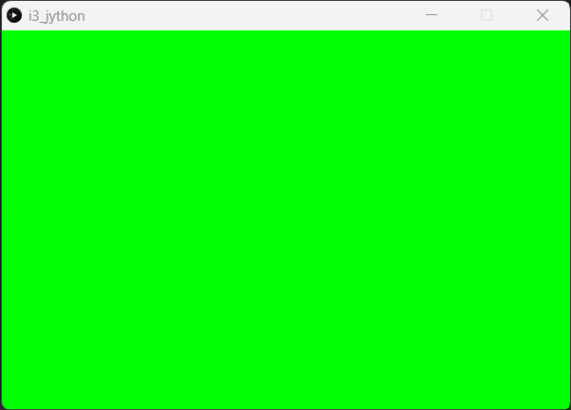
Simple canvas
The following example is taken from the package official website
https://pypi.org/project/processing-py/
The following program creates a canvas with a green background
from processing_py import *
app = App(600,400) # create window: width, height
app.background(0,255,0) # set background: red, green, blue
app.redraw() # refresh the window
#app.exit() # close the window

Slide 19
Point class
Let us create a point object, which has the following attributes
X location
Y location
Speed
And the following actions:
The point can show itself
The point can move around the canvas

Slide 20
class Point: def __init__(self,x,y): self.x = x self.y = y self.speed = 1
def show(self, app): app.fill(255,0,0) app.ellipse(self.x,self.y,10,10)
def move(self): self.x += self.speed self.y += self.speed
from processing_py import * app = App(600,600) p = Point(5,5) while True: app.background(0) p.move() p.show(app) app.redraw()

Slide 21
Extension
let us extend this example to create more than one object from the class point (several points)
We can add a list and fill it with objects from type Point
In the while loop (main loop) we iterate over the list of points and show and move each point

Slide 22
Cont.
The previous code creates a point moving diagonally along the canvas
Try to add more objects to the canvas
Observe the changes
As you might have noticed, the objects behave the same
because they have the same speed and same initial position
Assign the location for each point randomly

Slide 23
P5 package
Also, you can use p5 package to create animated objects
P5 is more complete and has more functionality that processing-py
p5 can be downloaded using: pip install p5
Also, you can see a full documentation in the following link
https://buildmedia.readthedocs.org/media/pdf/p5/latest/p5.pdf

Slide 24
point example with p5
def setup(): size(800, 600) def draw(): background(0) p.move() p.show() if __name__ == '__main__': run()
from p5 import * class Point: def __init__(self, x, y): self.x = x self.y = y def move(self): self.x += 1 self.y += 1
def show(self): ellipse(self.x, self.y, 50, 50)

Slide 25

To be continued
Let us study more OOP concepts, then we will come back to the processing again
Encapsulation
Inheritance
Overriding
Overloading
Polymorphism
Abstraction

